Slide 1
From Graphs to Tables: The Design of Scalable Systems for Graph Analytics
Joseph E. Gonzalez
Post-doc, UC Berkeley AMPLab
jegonzal@eecs.berkeley.edu
Co-founder, GraphLab Inc.
joseph@graphlab.com
WWW’14 Workshop on Big Graph Mining
*These slides are best viewed in PowerPoint with animation.

Slide 2
Graphs are Central to Analytics
Hyperlinks
PageRank
Top 20 Pages
Raw
Wikipedia
Text
Table
Title
PR
< / >
Title
Body
Term-Doc
Graph
Topic Model
(LDA)
< / >
< / >
Word Topics
XML
Word
Topic
Discussion
Table
Community
Detection
User
Community
Community
Topic
Editor Graph
User
Disc.
User
Com.
Topic
Com.

Slide 3
PageRank: Identifying Leaders
Rank of user i
Sum of neighbors
Update ranks in parallel
Iterate until convergence

Slide 4










Recommending Products
Users
Ratings
Items

Slide 5
Recommending Products
Low-Rank Matrix Factorization:
f(3)
r₁₃
Movies
f(1)
Netflix
≈
x
Users
Users
f(j)
r₁₄
f(4)
f(i)
User Factors (U)
Movie Factors (M)
r₂₄
f(2)
Movies
r₂₅
f(5)
Iterate:

Slide 6



Predicting User Behavior
?
?
Liberal
Conservative
?
?
?
?
?
?
?
?
Post
?
Post
?
Post
Post
?
Post
Post
Post
Post
?
Post
Post
Post
Post
?
Post
?
Post
?
?
?
?
?
Post
?
Post
Post
Post
Conditional Random Field
Belief Propagation
Post
Post
Post
?
Post
?
?
?
?
?
?
?

Slide 7
Mean Field Algorithm
X₃
X₂
Y₃
Post
Sum over Neighbors
X₁
Post
Y₂
Y₁
Post

Slide 8
Finding Communities
Count triangles passing through each vertex:
Measures “cohesiveness” of local community
2
3
1
4
Fewer Triangles
Weaker Community
More Triangles
Stronger Community

Slide 9
The Graph-Parallel Pattern
Model / Alg.
State
Computation depends only on the neighbors

Slide 10
Many Graph-Parallel Algorithms
Collaborative Filtering
Alternating Least Squares
Stochastic Gradient Descent
Tensor Factorization
Structured Prediction
Loopy Belief Propagation
Max-Product Linear Programs
Gibbs Sampling
Semi-supervised ML
Graph SSL
CoEM
Community Detection
Triangle-Counting
K-core Decomposition
K-Truss
Graph Analytics
PageRank
Personalized PageRank
Shortest Path
Graph Coloring
Classification
Neural Networks

Slide 11


Graph-Parallel Systems
Pregel
Expose specialized APIs to simplify graph programming.

Slide 12
The Pregel (Push) Abstraction
Vertex-Programs interact by sending messages.
Pregel_PageRank(i, messages) :
// Receive all the messages
total = 0
foreach( msg in messages) :
total = total + msg
// Update the rank of this vertex
R[i] = 0.15 + total
// Send new messages to neighbors
foreach(j in out_neighbors[i]) :
Send msg(R[i]) to vertex j
i
Malewicz et al. [PODC’09, SIGMOD’10]

Slide 13
The GraphLab (Pull) Abstraction
Vertex Programs directly access adjacent vertices and edges
GraphLab_PageRank(i)
// Compute sum over neighbors
total = 0
foreach( j in neighbors(i)):
total = total + R[j] * w_{ji}
// Update the PageRank
R[i] = 0.15 + total
R[4] * w₄₁
4
+
1
R[3] * w₃₁
R[2] * w₂₁
+
3
2
Data movement is managed by the system and not the user.

Slide 14
Iterative Bulk Synchronous Execution
Compute
Communicate
Barrier
Notes:
Put equation on slide

Slide 15
Graph-Parallel Systems
Pregel
Exploit graph structure to achieve orders-of-magnitude performance gains over more general data-parallel systems.

Slide 16
Real-World Graphs
Edges >> Vertices
Power-Law Degree Distribution
AltaVista WebGraph1.4B Vertices, 6.6B Edges
More than 10⁸ vertices have one neighbor.
Top 1% of vertices are adjacent to
50% of the edges!
-Slope = α ≈ 2
Number of Vertices
Degree

Slide 17
Challenges of High-Degree Vertices
Sequentially process edges
Touches a large
fraction of graph
CPU 1
CPU 2
Provably Difficult to Partition
Notes:
Power-Law graphs do not have low-cost balanced cuts [Leskovec et al. 08, Lang 04]
Traditional graph-partitioning algorithms perform poorly on Power-Law Graphs. [Abou-Rjeili et al. 06]

Slide 18
GraphLab
(PowerGraph, OSDI’12)
Program This
Run on This
Machine 1
Machine 2
Split High-Degree vertices
New Abstraction → Equivalence on Split Vertices

Slide 19
GAS Decomposition
Machine 1
Machine 2
Master
Gather
Y’
Y’
Y’
Y’
Σ₁
Σ
Σ₂
+ + +
Mirror
Apply
Y
Y
Y
Y
Machine 3
Machine 4
Scatter
Σ₃
Σ₄
Mirror
Mirror

Slide 20
Minimizing Communication in PowerGraph
Vertex Cut
Communication is linear in the number of machines each vertex spans.
Y
Y
Y
Total communication upper bound:

Slide 21
Shrinking Working Sets
PageRank on Web Graph
51% of vertices run only once!

Slide 22
The GraphLab (Pull) Abstraction
Vertex Programs directly access adjacent vertices and edges
GraphLab_PageRank(i)
// Compute sum over neighbors
total = 0
foreach( j in neighbors(i)):
total = total + R[j] * w_{ji}
// Update the PageRank
R[i] = 0.15 + total
R[4] * w₄₁
GraphLab_PageRank(i)
// Compute sum over neighbors
total = 0
foreach( j in neighbors(i)):
total = total + R[j] * w_{ji}
// Update the PageRank
R[i] = 0.15 + total
// Trigger neighbors to run again
if R[i] not converged then
signal nbrsOf(i) to be recomputed
4
+
1
R[3] * w₃₁
R[2] * w₂₁
+
3
2
Trigger computation only when necessary.

Slide 23
PageRank on the Live-Journal Graph
GraphLab is 60x faster than Hadoop
GraphLab is 16x faster than Spark

Slide 24
Triangle Counting on Twitter
40M Users, 1.4 Billion Links
Counted: 34.8 Billion Triangles
Hadoop [WWW’11]
1536 Machines
423 Minutes
64 Machines
15 Seconds
1000 x Faster
GraphLab
S. Suri and S. Vassilvitskii, “Counting triangles and the curse of the last reducer,” WWW’11

Slide 25
Graph Analytics Pipeline
Hyperlinks
PageRank
Top 20 Pages
Raw
Wikipedia
Text
Table
Title
PR
< / >
Title
Body
Term-Doc
Graph
Topic Model
(LDA)
< / >
< / >
Word Topics
XML
Word
Topic
Discussion
Table
Community
Detection
User
Community
Community
Topic
Editor Graph
User
Disc.
User
Com.
Topic
Com.

Slide 26
Tables
Hyperlinks
PageRank
Top 20 Pages
Raw
Wikipedia
Text
Table
Title
PR
< / >
Title
Body
Term-Doc
Graph
Topic Model
(LDA)
< / >
< / >
Word Topics
XML
Word
Topic
Discussion
Table
Community
Detection
User
Community
Community
Topic
Editor Graph
User
Disc.
User
Com.
Topic
Com.

Slide 27
Graphs
Hyperlinks
PageRank
Top 20 Pages
Raw
Wikipedia
Text
Table
Title
PR
< / >
Title
Body
Term-Doc
Graph
Topic Model
(LDA)
< / >
< / >
Word Topics
XML
Word
Topic
Discussion
Table
Community
Detection
User
Community
Community
Topic
Editor Graph
User
Disc.
User
Com.
Topic
Com.

Slide 28


Separate Systems to Support Each View
Table View
Graph View
Pregel
Table
Dependency Graph
Row
Row
Result
Row
Row
Notes:
----- Meeting Notes (1/5/14 14:58) -----
Spark too.

Slide 29
Separate systems for each view can be difficult to use and inefficient

Slide 30


Difficult to Program and Use
Users must Learn, Deploy, and Manage multiple systems
Leads to brittle and often complex interfaces

Slide 31
Inefficient
Extensive data movement and duplication across the network and file system
< / >
< / >
< / >
XML
HDFS
HDFS
HDFS
HDFS
Limited reuse internal data-structures across stages

Slide 32
Solution: The GraphX Unified Approach
New API
Blurs the distinction between Tables and Graphs
New System
Combines Data-Parallel Graph-Parallel Systems
Enabling users to easily and efficiently express the entire graph analytics pipeline

Slide 33
Tables and Graphs are composable views of the same physical data
GraphX Unified
Representation
Table View
Graph View
Each view has its own operators that exploit the semantics of the view
to achieve efficient execution
Notes:
and users can move between views without copying or moving data

Slide 34
View a Graph as a Table
Vertex Property Table
Property Graph
Id
Rxin
Jegonzal
Franklin
Istoica
Property (V)
(Stu., Berk.)
(PstDoc, Berk.)
(Prof., Berk)
(Prof., Berk)
R
F
Edge Property Table
SrcId | DstId
rxin | jegonzal
franklin | rxin
istoica | franklin
franklin | jegonzal
Property (E)
Friend
Advisor
Coworker
PI
J
I

Slide 35
Table Operators
Table (RDD) operators are inherited from Spark:
map
filter
groupBy
sort
union
join
leftOuterJoin
rightOuterJoin
reduce
count
fold
reduceByKey
groupByKey
cogroup
cross
zip
sample
take
first
partitionBy
mapWith
pipe
save
...

Slide 36
Graph Operators
class Graph [ V, E ] {
def Graph(vertices: Table[ (Id, V) ],
edges: Table[ (Id, Id, E) ])
// Table Views -----------------
def vertices: Table[ (Id, V) ]
def edges: Table[ (Id, Id, E) ]
def triplets: Table [ ((Id, V), (Id, V), E) ]
// Transformations ------------------------------
def reverse: Graph[V, E]
def subgraph(pV: (Id, V) => Boolean,
pE: Edge[V,E] => Boolean): Graph[V,E]
def mapV(m: (Id, V) => T ): Graph[T,E]
def mapE(m: Edge[V,E] => T ): Graph[V,T]
// Joins ----------------------------------------
def joinV(tbl: Table [(Id, T)]): Graph[(V, T), E ]
def joinE(tbl: Table [(Id, Id, T)]): Graph[V, (E, T)]
// Computation ----------------------------------
def mrTriplets(mapF: (Edge[V,E]) => List[(Id, T)], reduceF: (T, T) => T): Graph[T, E]
}
Notes:
Make mrTriplets more visible.

Slide 37
Triplets Join Vertices and Edges
The triplets operator joins vertices and edges:
SELECT s.Id, d.Id, s.P, e.P, d.P
FROM edges AS e
JOIN vertices AS s, vertices AS d
ON e.srcId = s.Id AND e.dstId = d.Id
Vertices
Triplets
Edges
A
A
A
A
B
B
B
B
A
C
A
C
C
B
C
B
C
D
C
D
C
D
The mrTriplets operator sums adjacent triplets.
SELECT t.dstId, reduce( map(t) ) AS sum
FROM triplets AS t GROUPBY t.dstId
Notes:
w

Slide 38
We express enhanced Pregel and GraphLab abstractions using the GraphX operators in less than 50 lines of code!

Slide 39
Enhanced to Pregel in GraphX
Require Message Combiners
pregelPR(i, messageList ):
messageSum
// Receive all the messages
total = 0
foreach( msg in messageList) :
total = total + msg
messageSum
// Update the rank of this vertex
R[i] = 0.15 + total
combineMsg(a, b):
// Compute sum of two messages
return a + b
Remove Message Computation from the
Vertex Program
// Send new messages to neighbors
foreach(j in out_neighbors[i]) :
Send msg(R[i]/E[i,j]) to vertex
sendMsg(i→j, R[i], R[j], E[i,j]):
// Compute single message
return msg(R[i]/E[i,j])
Malewicz et al. [PODC’09, SIGMOD’10]

Slide 40
Implementing PageRank in GraphX
// Load and initialize the graph
val graph = GraphBuilder.text(“hdfs://web.txt”)
val prGraph = graph.joinVertices(graph.outDegrees)
// Implement and Run PageRank
val pageRank =
prGraph.pregel(initialMessage = 0.0, iter = 10)(
(oldV, msgSum) => 0.15 + 0.85 * msgSum,
triplet => triplet.src.pr / triplet.src.deg,
(msgA, msgB) => msgA + msgB)

Slide 41
We express the Pregel and GraphLab like abstractions using the GraphX operators in less than 50 lines of code!
By composing these operators we can construct entire graph-analytics pipelines.

Slide 42
Example Analytics Pipeline
// Load raw data tables
val verts = sc.textFile(“hdfs://users.txt”).map(parserV)
val edges = sc.textFile(“hdfs://follow.txt”).map(parserE)
// Build the graph from tables and restrict to recent links
val graph = new Graph(verts, edges)
val recent = graph.subgraph(edge => edge.date > LAST_MONTH)
// Run PageRank Algorithm
val pr = graph.PageRank(tol = 1.0e-5)
// Extract and print the top 25 users
val topUsers = verts.join(pr).top(25).collect
topUsers.foreach(u => println(u.name + ‘\t’ + u.pr))

Slide 43
GraphX System Design

Slide 44
Distributed Graphs as Tables (RDDs)
Vertex Table (RDD)
Routing
Table (RDD)
Edge Table
(RDD)
Property Graph
Part. 1
A
B
B
A
A
1
2
B
C
C
A
C
B
B
1
B
C
C
D
A
A
A
D
D
D
C
C
1
2D Vertex Cut Heuristic
A
D
Part. 2
A
E
D
D
1
2
A
F
F
F
E
E
E
E
2
E
D
F
F
2
E
F

Slide 45
Caching for Iterative mrTriplets
Vertex Table (RDD)
Edge Table
(RDD)
Mirror
Cache
A
B
A
A
A
A
A
C
B
B
B
B
C
C
D
C
D
C
C
Mirror
Cache
A
E
D
D
D
A
A
F
E
D
E
E
D
E
F
F
F
E
F

Slide 46
Incremental Updates for Iterative mrTriplets
Vertex Table (RDD)
Edge Table
(RDD)
Mirror
Cache
A
B
Change
A
A
A
A
A
C
B
B
B
C
C
D
C
D
C
Mirror
Cache
A
E
D
A
A
F
D
Change
E
Scan
E
E
D
E
F
F
E
F

Slide 47
Aggregation for Iterative mrTriplets
Vertex Table (RDD)
Edge Table
(RDD)
Mirror
Cache
A
B
Change
A
A
A
C
Local
Aggregate
B
B
Change
B
B
C
C
C
D
C
D
Change
C
Mirror
Cache
A
E
Change
D
A
A
F
Local
Aggregate
D
E
Scan
Change
D
E
D
E
Change
F
F
F
E
F

Slide 48
Reduction in Communication Due to Cached Updates
Most vertices are within 8 hops of all vertices in their comp.

Slide 49
Benefit of Indexing Active Edges
Scan All Edges
Index of “Active” Edges

Slide 50
Join Elimination
Identify and bypass joins for unused triplet fields
sendMsg(i→j, R[i], R[j], E[i,j]):
// Compute single message
return msg(R[i]/E[i,j])
Factor of 2 reduction in communication

Slide 51
Additional Query Optimizations
Indexing and Bitmaps:
To accelerate joins across graphs
To efficiently construct sub-graphs
Substantial Index and Data Reuse:
Reuse routing tables across graphs and sub-graphs
Reuse edge adjacency information and indices
Notes:
Split Hash Table: reuse key sets across hash tables

Slide 52
Performance Comparisons
Live-Journal: 69 Million Edges
GraphX is roughly 3x slower than GraphLab

Slide 53
GraphX scales to larger graphs
Twitter Graph: 1.5 Billion Edges
GraphX is roughly 2x slower than GraphLab
Scala + Java overhead: Lambdas, GC time, …
No shared memory parallelism: 2x increase in comm.

Slide 54
PageRank is just one stage…. What about a pipeline?

Slide 55
A Small Pipeline in GraphX
Raw Wikipedia
Hyperlinks
PageRank
Top 20 Pages
< / >
< / >
< / >
HDFS
HDFS
XML
Spark Preprocess
Compute
Spark Post.
605
375
Timed end-to-end GraphX is faster than GraphLab
Notes:
Also faster in human time but it is hard to measure.

Slide 56
Conclusion and Observations
Domain specific views: Tables and Graphs
tables and graphs are first-class composable objects
specialized operators which exploit view semantics
Single system that efficiently spans the pipeline
minimize data movement and duplication
eliminates need to learn and manage multiple systems
Graphs through the lens of database systems
Graph-Parallel Pattern → Triplet joins in relational alg.
Graph Systems → Distributed join optimizations

Slide 57
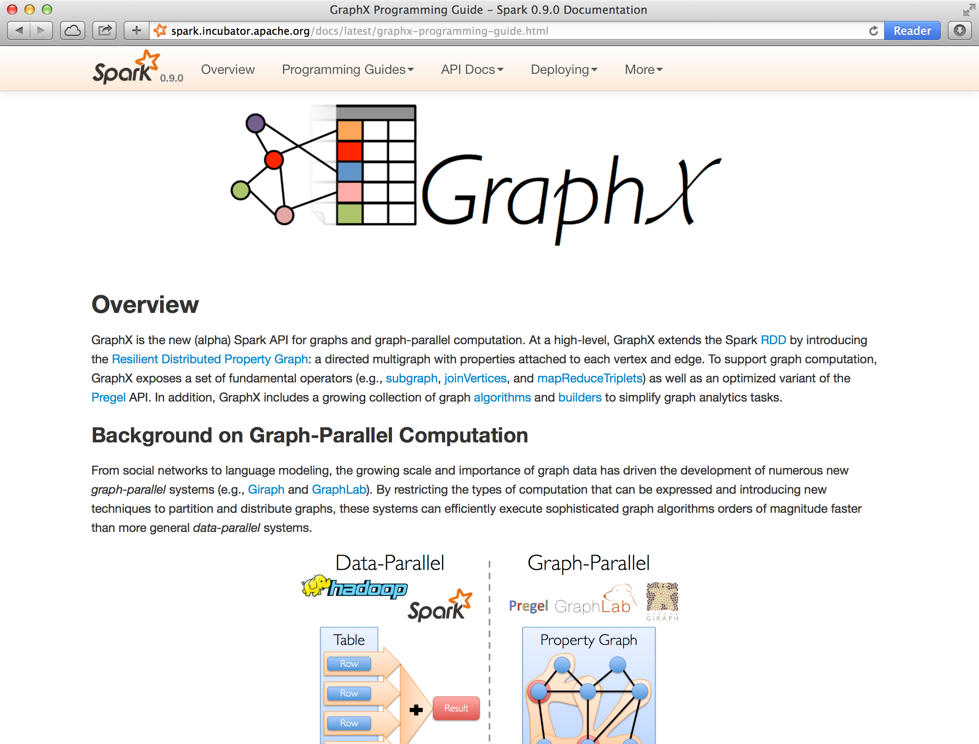
Open Source Project
Alpha release as part of Spark 0.9

Slide 58
Active Research
Static Data → Dynamic Data
Apply GraphX unified approach to time evolving data
Materialized view maintenance for graphs
Serving Graph Structured Data
Allow external systems to interact with GraphX
Unify distributed graph databases with relational database technology

Slide 59




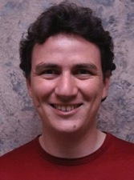

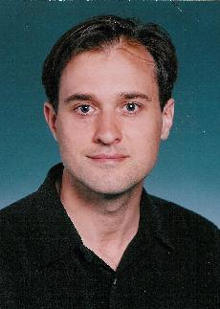
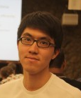

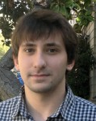


Collaborators
GraphLab:
Yucheng
Low
Haijie
Gu
Aapo
Kyrola
Danny
Bickson
Carlos
Guestrin
Alex
Smola
Guy
Blelloch
GraphX:
Reynold
Xin
Ankur
Dave
Daniel
Crankshaw
Michael
Franklin
Ion
Stoica

Slide 60
Thanks!
http://tinyurl.com/ampgraphx
jegonzal@eecs.berkeley.edu

